Slide 1
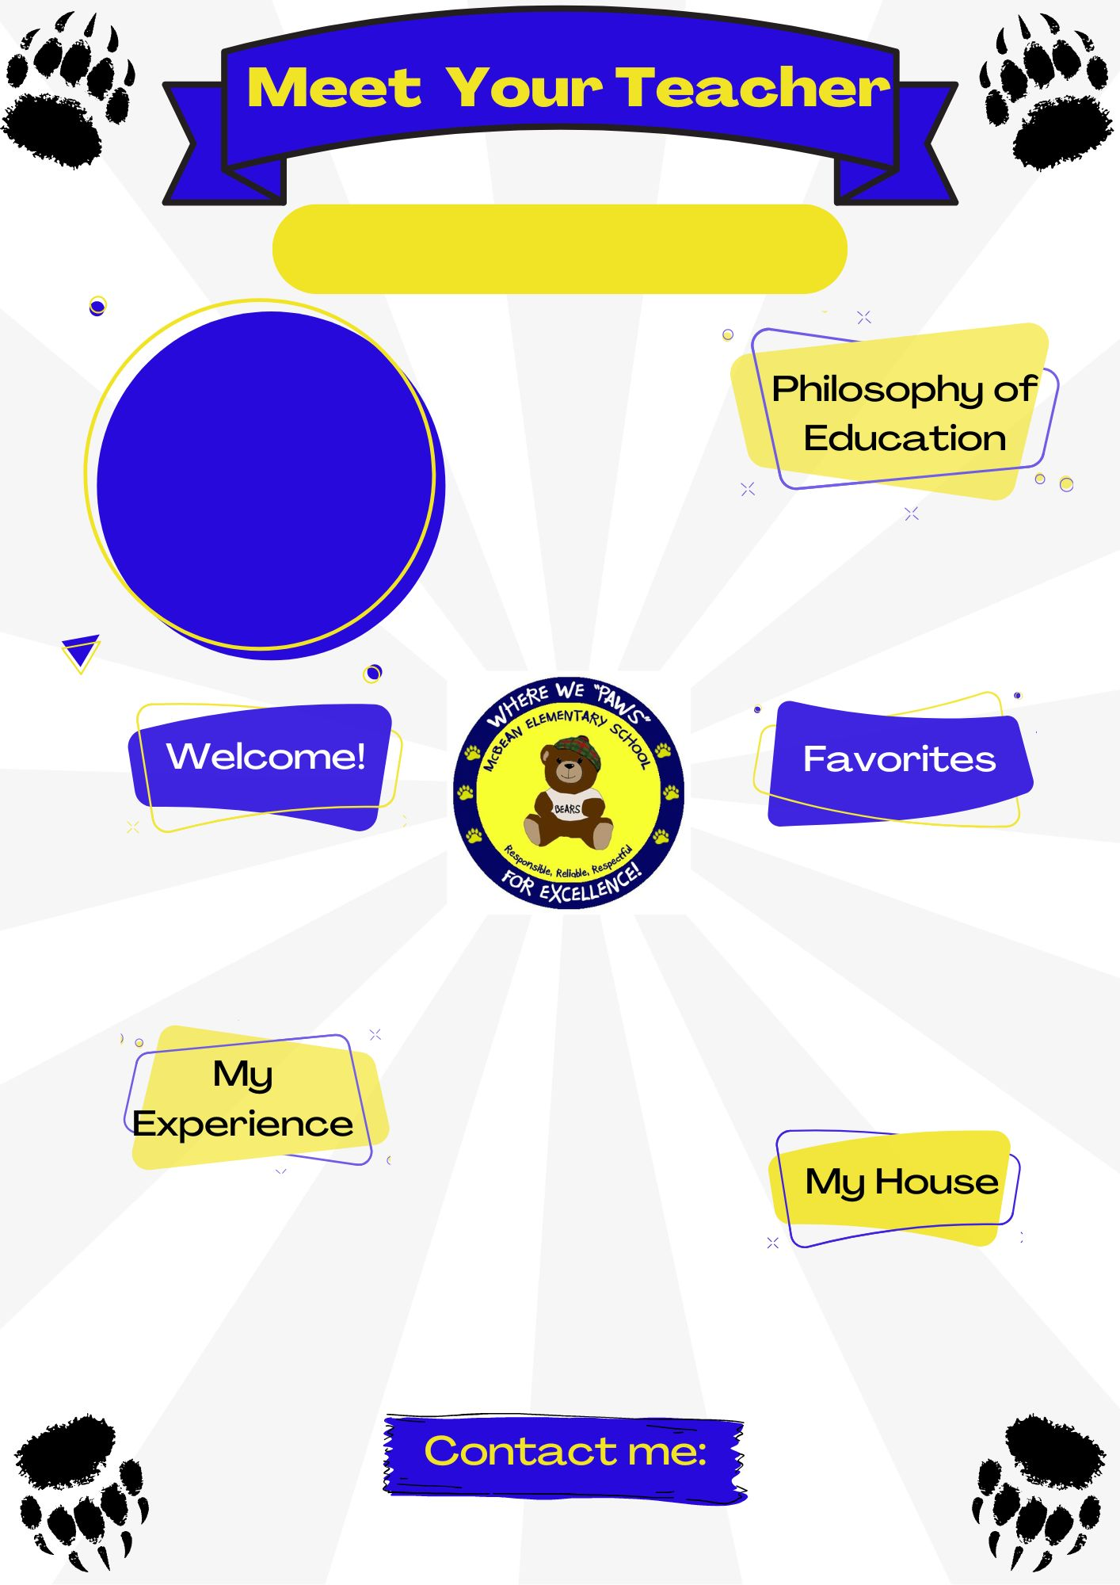
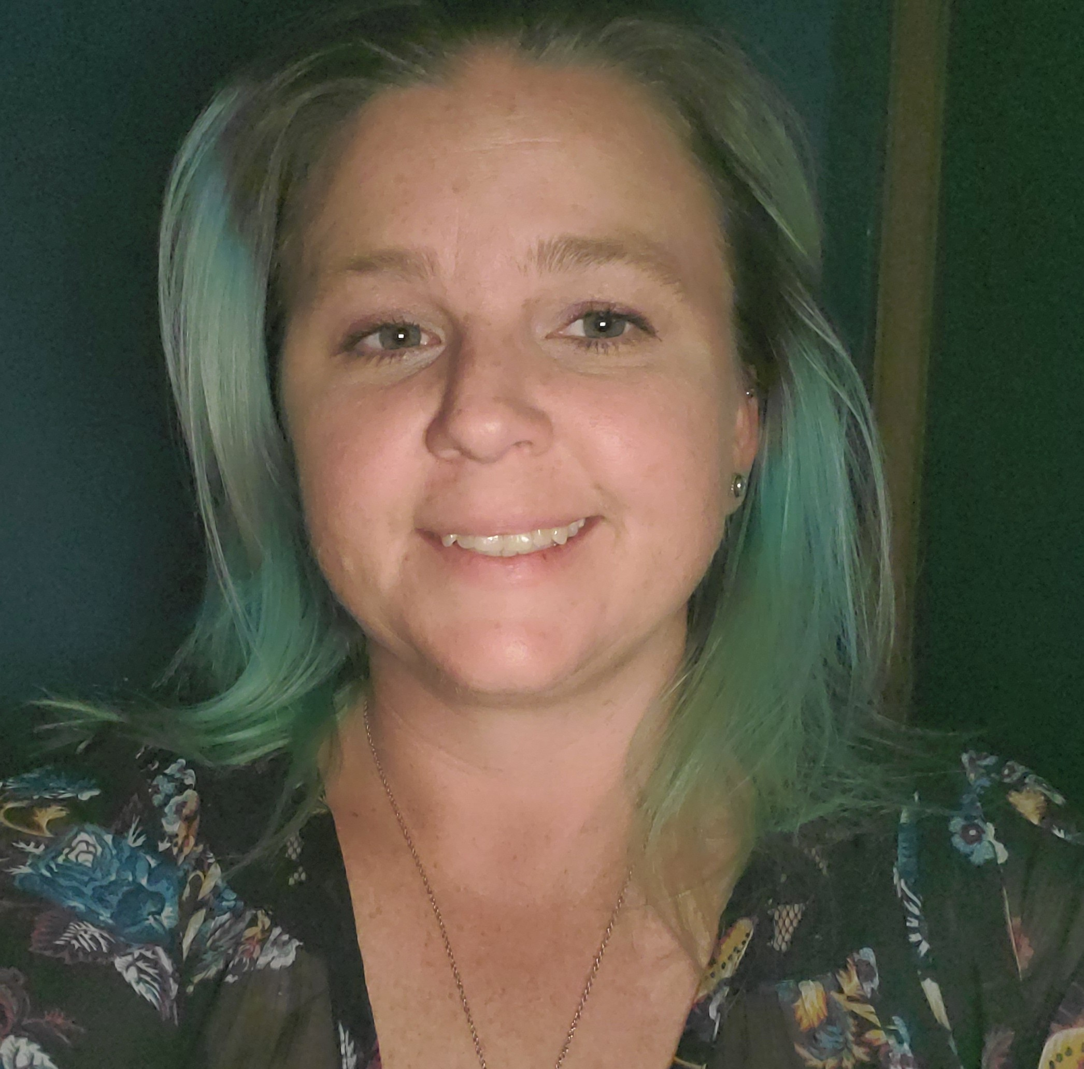

Ms. Criss
First Grade
Teaching is my passion, and I take great pride in the positive impact I have in students' lives and our community. Laying the foundation for education and lifelong success is an honor! Instilling a Growth Mindset in my classroom is a priority!
Welcome to my classroom, I am so excited for our year together! We will learn and grow so much together! I am proud to be apart of team McBean!
Color(s): Bright Green
Animal(s): Dogs and Owls
Hobby: Hiking
Sport: Softball
Book: I Like Myself by: Karen Beaumont
Movie: Monsters Inc.
Food: Tacos
Drink: Coffee
I received my Bachelor in Elementary Education from University of South Florida, in Tamp FL (go Bulls!) In addition, I earned an Exceptional Student Education, ESOL and Reading Literacy endorsement. I am looking forward to my 9th year teaching.
CrissJe@BOE.richmond.k12.ga.us

